Slide 1


YOUTUBE ANALYTICS

Slide 2
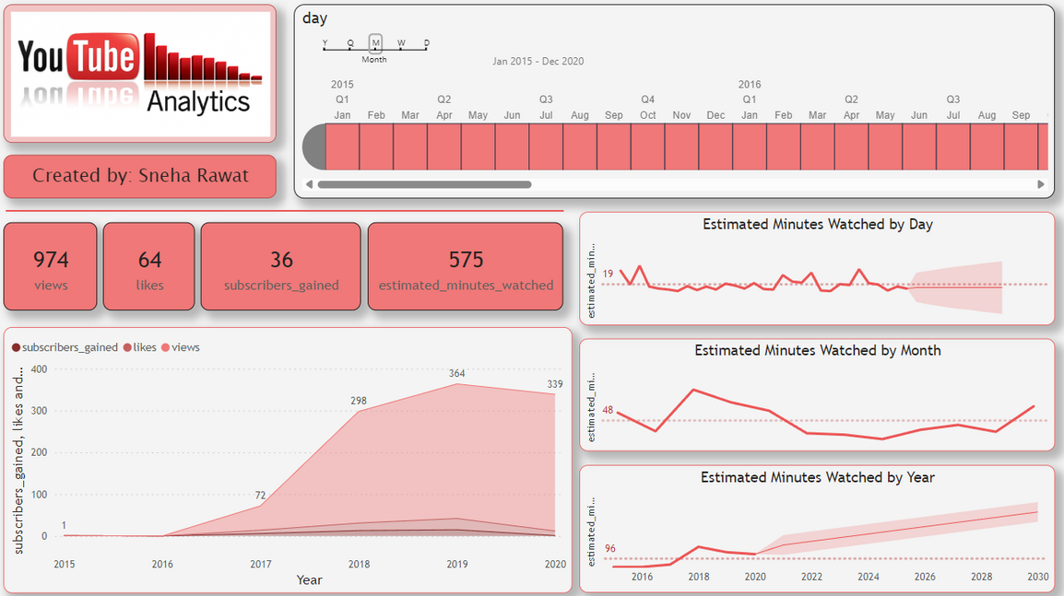

Slide 3
Welcome To Our Presentation
This image is a YouTube Analytics dashboard that provides an overview of various metrics related to a YouTube channel's performance. Here's an easy-to-understand explanation of each section:
Top Left (YouTube Analytics Logo):
This is the logo and title of the dashboard indicating it’s about YouTube Analytics.
Middle Left (Created by: Sneha Rawat):
This section credits the creator of the dashboard.

Slide 5
4.. Middle Section (Summary Statistics):
974 views: Total number of times videos have been watched.
64 likes: Total number of likes received.
36 subscribers gained: Number of new subscribers.
575 estimated minutes watched: Total estimated watch time in minutes.
5. Right Section (Estimated Minutes Watched Charts):
By Day: Shows a daily trend of estimated minutes watched.
By Month: Displays a monthly trend of estimated minutes watched.
By Year: Presents a yearly trend of estimated minutes watched.

Slide 7
6. Bottom Section (Subscribers Gained, Likes, and Views Over Time):
This graph shows the yearly trend of subscribers gained, likes, and views from 2015 to 2020. Each metric has a different color for easy distinction:
Subscribers gained: Pink shaded area.
Likes: Red line.
Views: Grey shaded area.
Overall, this dashboard provides a comprehensive view of how a YouTube channel is performing over different time periods in terms of views, likes, subscribers, and watch time.

Slide 8
Thank You

